Slide 1
Role Models Matter: Engaging Girls (and All Kids) in STEM
September 2015
Revision A
Notes:
WORKSHOP SET-UP:
Pass out markers or colored pencils or pens, notecards and/or sticky notes for workshop activities.
Distribute pipe cleaners or other fidget materials (squeeze balls, play-doh, etc.).
Have hands-on activity materials distributed or ready to be distributed.
Be sure to have read the Changing the Conversation report and the Why So Few? report so you can answer questions related to the slides that reference the research.
Collect total number of workshop participants to report back to TxGCP per grant requirements. See http://tinyurl.com/TxGCP-RoleModels for demographics details and to submit workshop demographics after the event.
NOTE on Slide Template: WEP logo on right can be swapped out with the logo of the organization presenting. Other logos should remain on the slides per dissemination grant requirements.
Introduction Slide – Facilitation Tip:
Model role model introduction: share a bit about who you are and your interest in role models and/or engaging kids in STEM – make it personal

Slide 2
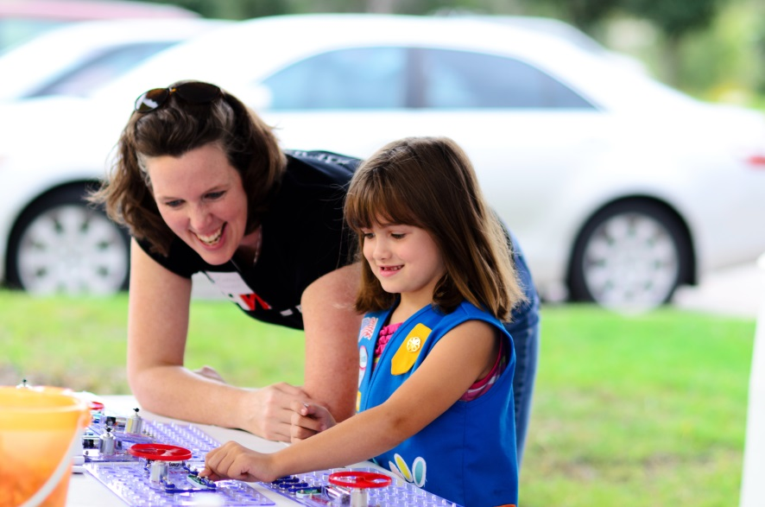
Workshop Goals
To learn…
what information to share with girls/kids
strategies to engage girls/kids
To connect…
with resources
with each other
Notes:
The goals of the Role Models Matter workshop are focused on learning and connecting. At the end of the workshop, the aim is to have you understand what information to share about STEM with students as well as strategies to engage them in STEM. You will also learn about resources to support your outreach efforts and will hopefully connect a bit more with each other.

Slide 3
What does a girl (or any student) imagine when she thinks of a scientist or engineer?
Notes:
ACTIVITY:
Ask participants to use a notecard or post-it note and to draw or describe what a girl (or really any kid) imagines when she thinks of a scientist or an engineer. Give 1 minute for people to draw by themselves – give a bit more time if needed. After 1 minute, give them another minute or so to share their drawing in groups of 2 or 3. Ask them to see what they have in common across their depictions. Close the activity with having them share with the whole group things they drew.
Lead-in to next slide: This activity was asked of 7th grade kids heading to a tour of Fermilab, a national lab run by the US Department of Energy. The kids were asked to both draw and describe a scientist.

Slide 4
Before Role Model Experience
I think of a scientist as very dedicated to his work. He is kind of crazy, talking always quickly. He constantly is getting new ideas. He is always asking questions and can be annoying. He listens to others' ideas and questions them.
-Amy, 7th grader
Notes:
This is what Amy thought about scientists before the tour and before interactions with role model scientists.
Notice some of the phrases Amy uses and what they may mean:
“Very dedicated to his work” ---may mean has no social life and just works all the time
“Crazy, talking always quickly” ---may mean that it’s hard to understand them
Ask participants if there are any other things that strike them from the description.

Slide 5
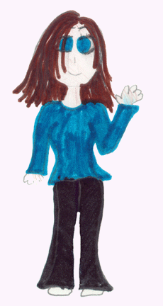
After Role Model Experience
I know scientists are just normal people with a not so normal job. . . . Scientists lead a normal life outside of being a scientist. They are interested in dancing, pottery, jogging and even racquetball. Being a scientist is just another job which can be much more exciting.
-Amy, 7th grader
http://ed.fnal.gov/projects/scientists/index.html
Notes:
After the tour and after interactions with lots of diverse scientists, this is what Amy drew and described afterwards. She describes scientists by talking about their personal lives and that they are just like other people. This description of a scientist is much more attainable to Amy – she can probably envision herself in this role now.

Slide 6
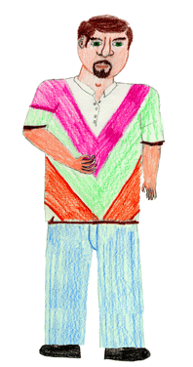
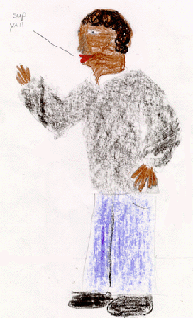
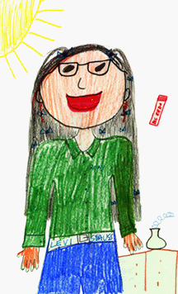
Notes:
And here are even more pictures from after the visit. Again, you can see the diversity that kids can see after the visit. They can see that scientists are more like them.
There is great power in kids having experiences with STEM role models!

Slide 7
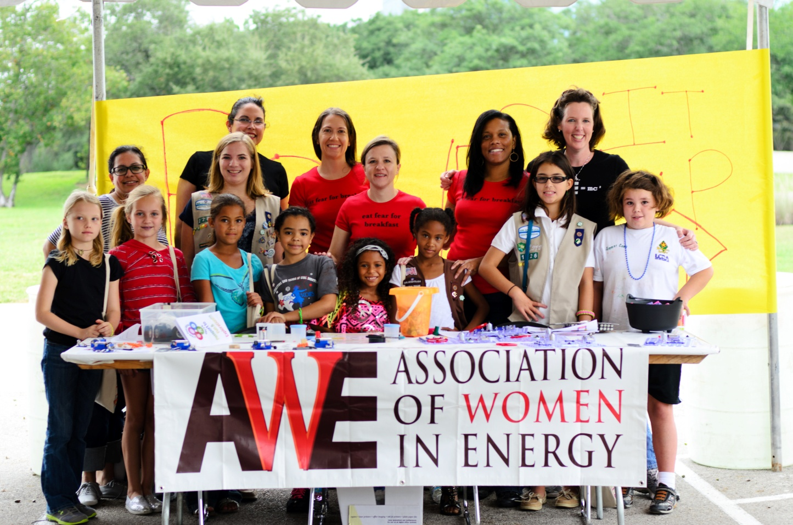
Why Train Role Models?
Notes:
Why is it important to train role models?
Helps role models feel more comfortable. They aren’t used to working with kids necessarily.
Helps provide role models with the goals of the interaction and helps them better support the effort (getting kids interested in a certain industry, excited about robotics, interested in a certain university, etc.)
Can improve the impact by ensuring best practices are used and the right message is sent

Slide 8
CHANGING THE CONVERSATION: Messages for Improving Public Understanding of Engineering
National Academy Of Engineering (NAE)
http://www.nap.edu/catalog.php?record_id=12187
Notes:
We’re going to start with best practices on messaging. The information comes from a couple of great research reports – you are going to get the Cliff Notes version today.
The first report is Changing the Conversation: Messages for Improving Public Understanding of Engineering from the National Academy of Engineering.
http://www.nap.edu/catalog.php?record_id=12187

Slide 9
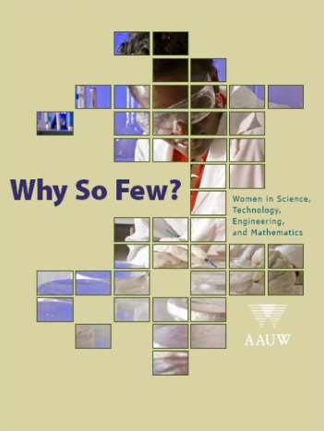
Why So Few?
Women in Science, Technology, Engineering and Mathematics
American Association of University Women
http://www.aauw.org/learn/research/whysofew.cfm
Notes:
The second report is called Why So Few? Women in STEM from the American Association of University Women. http://www.aauw.org/learn/research/whysofew.cfm
And while these reports may have focused on engineering or women, the research applies more broadly to other STEM fields and shares best practices to engage all kids in STEM. The research has also been repeated by organizations such as the Girl Scouts and Intel and the recommendations in messaging and approaches continue to be the same.

Slide 10
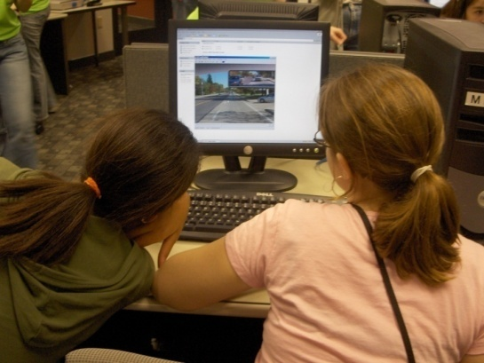
Engineering Messages Recommendations
(or STEM)
^
Describe engineering: discovery, design, imagination, innovation, contribution
Describe engineers: creative problem solvers, essential to health, happiness and safety, shape the future
Use the word create, not build
Notes:
You’ll see “or STEM” added in here as this research was focused on engineering but is easily applicable to other STEM disciplines as well.
First off, the research identified words and phrases that caught the attention of kids and made them connect more with engineering. Sharing how engineers -- or you in your own work – design products, use their imagination, and contribute to our world can excite kids about engineering. We should show how engineers are creative problem solvers or how they are essential to our health, happiness and safety and provide real world examples.
And one simple word switch the research found is to use the word create instead of build. When you think of the word build, what do you think of? (Let participants share their thoughts.) LEGOs come with instructions and kids follow the step-by-step instructions to build whatever is on the front of the box. Create comes from when there are no instructions and there is just a big bin of LEGOs to work from. How much of engineering and science is build? How much of it is following step-by-step instructions to get to a solution? Almost none of it! Engineering and science is all about creative problem solving – there are no instructions.

Slide 11
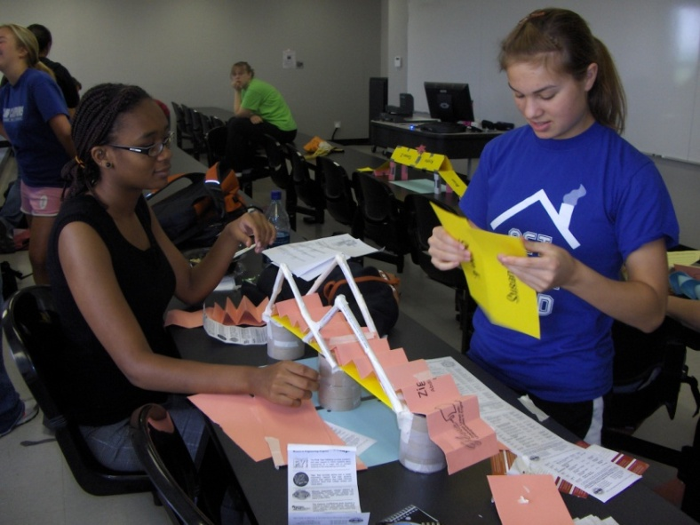
Engineering Messages Recommendations
(or STEM)
^
Stop reinforcing images of nerdy & boring
Stop focusing on math and science as the needed inputs and instead focus on:
Outputs
Career opportunities
Making a difference in the world
Notes:
The research also indicated that kids don’t think of engineers as nerdy and boring. We don’t need to reinforce those images. We need to avoid the geek and nerd images.
We also need to stop focusing on the math and science. The research is not saying that math and science aren’t important. What it is saying is that kids get that. Kids (and their teachers and parents) know that math and science are important for those heading into STEM majors. What they don’t know (and what their parents and teachers often don’t know) is what you can actually do with a STEM degree. As role models, we need to showcase what you can do with these degrees – what are some real world examples of engineers making our world a better place.
Some believe that kids are ok with “geek”. Those who embrace “geek” are already part of that group: “I’m a band geek.” or “I’m a math geek.” or “I’m a robot geek.” It creates a barrier to those who are not part of that group. It excludes those who are not already there. And if we want to get all kids taking more math and science and considering a STEM major or career in the future, we can’t exclude them by putting up barriers and making them feel like an outsider outside of the “geek” club. Reference: http://www.theatlantic.com/business/archive/2013/09/the-brogrammer-effect-women-are-a-small-and-shrinking-share-of-computer-workers/279611/

Slide 12
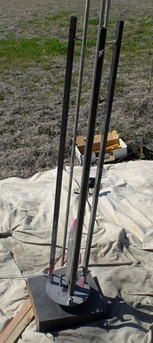
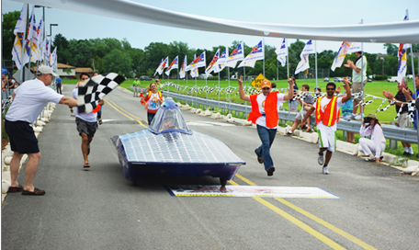
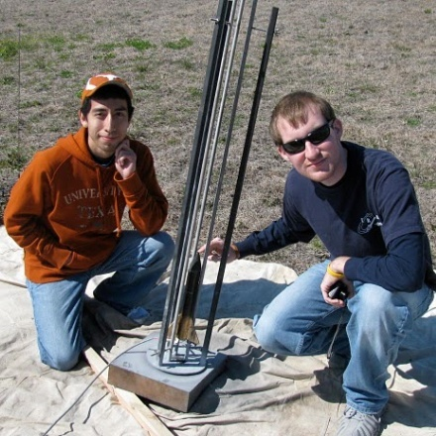
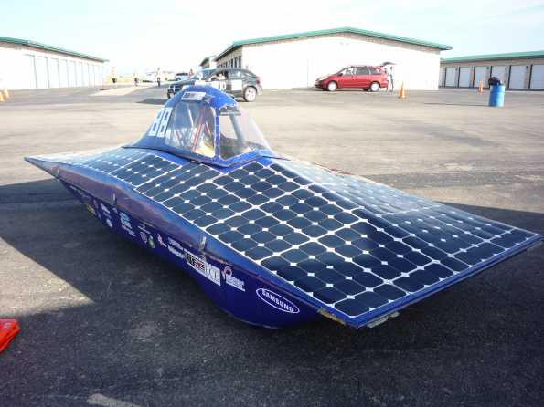
Engineering Messages Recommendations
(or STEM)
^
Use images of people, not things; especially avoid using gears and mechanical looking things
Notes:
Images also matter in grabbing the attention of kids. For girls in particular, images of people are important. We can’t just have images of gadgets and technology in our presentations, videos, websites, and flyers. Boys are ok with just the technology. But to engage all kids we need to include people with the technology. Boys will still see the technology even if there are people in the picture.

Slide 13
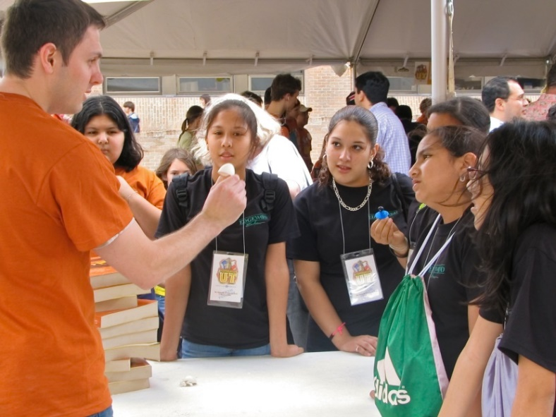
What are Key elements of a role model interaction?
Notes:
Now that you know some of the keys around messaging to kids about STEM, let’s move into the key elements of a role model interaction. What are some key elements of a role model interaction? When a role model goes into a classroom or is volunteering in a program, what are some of the key things that should happen?

Slide 14
Notes:
The most successful role model interactions include this “secret sauce”: 1 part passion, 1 part personal, 1 part informal and 1 part interactive. Role models who are the most successful are passionate about what they share with students. They make it personal and share their story of experiences, struggles, life outside of work. The experience is informal and interactive – kids aren’t tested on the material and they aren’t just lectured to by the role model. When you mix all of that up, you have a great experience for both the role model and the students.

Slide 15
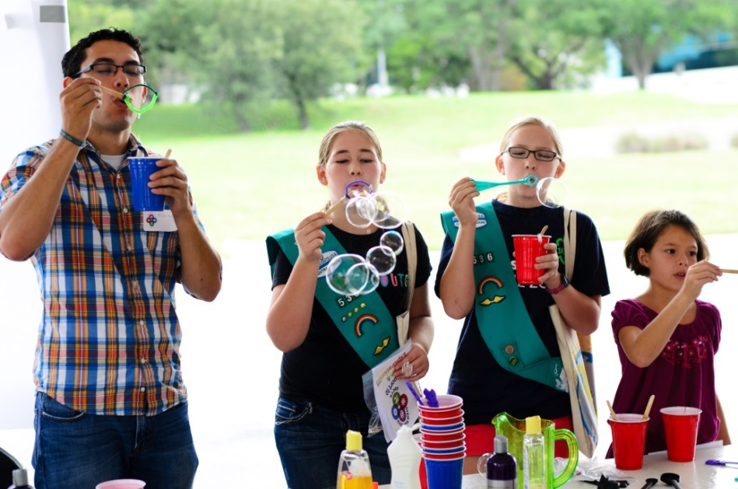
Key Elements of a Role Model Interaction
Make it personal
Use kid-friendly language
Share academic and/or career path
Share challenges and triumphs
Show how engineers can change the world
These elements should be threaded throughout a role model interaction!
Notes:
OPTIONAL SLIDE – if time is short, this slide could be skipped.
These are some of the key elements of a role model interaction to help achieve that secret sauce. We’ve talked already about some of the messaging pieces, but it’s also important to make it personal. We’ll talk about these a bit more as we go through the activities of a role model visit.

Slide 16
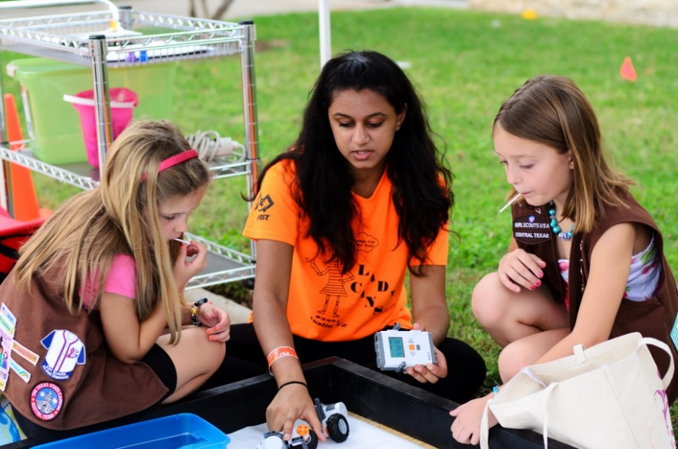
Role Model Event
Icebreaker (10 minutes)
Role model introductions (10 minutes)
Hands-on STEM activity
Reflection and connections to the world (10+ minutes)
Notes:
A typical role model event includes these components: an icebreaker, introductions, a hands-on activity and then a reflection and connection to the real world. This event structure is set up for about an hour interaction.

Slide 17
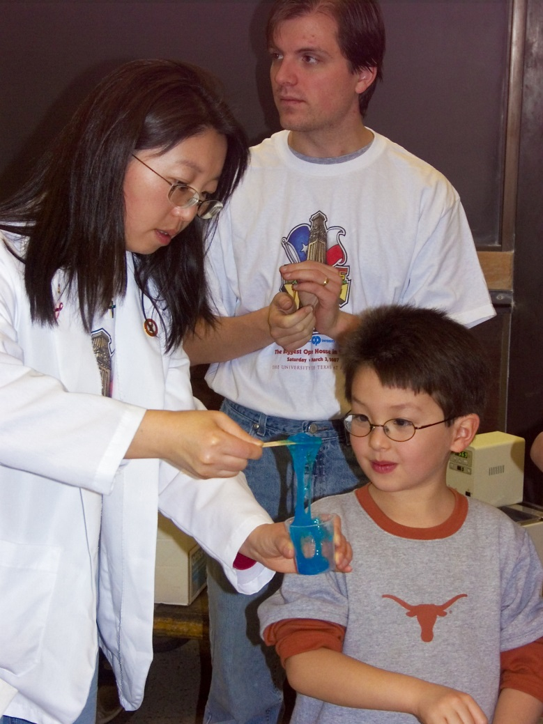
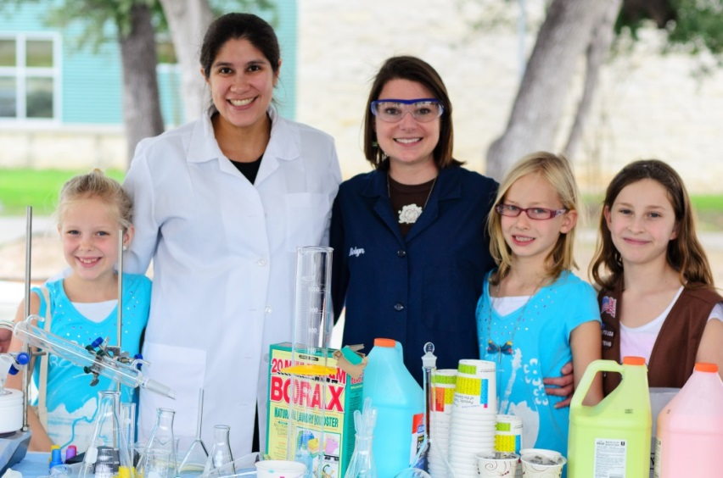
Ice Breaker
Notes:
Why might an ice breaker be a good way to kick off a role model visit?

Slide 18
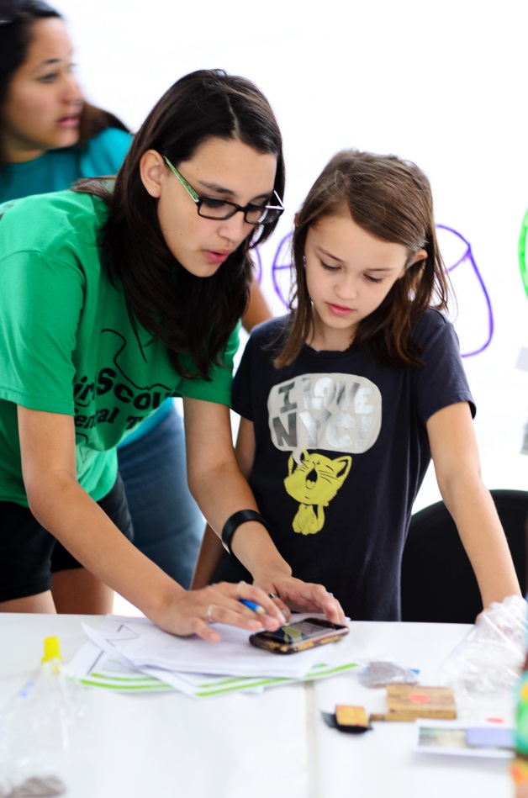
Icebreakers can...
Make students and role models more comfortable
Introduce new scientific topics, vocabulary or careers
Check for background knowledge
Notes:
For a role model visit, an ice breaker with the kids is not the same as speed networking like we did earlier. It isn’t about getting to know the names of the kids or having them get comfortable with each other.
Icebreakers can help make the students and role models more comfortable with each other. It sets the tone for the visit and starts to create a relationship between the role model and the students.
It can also introduce some topics and vocabulary or check for some background knowledge that may help connect to the activity. The role model can use the ice breaker to get a handle on what the kids already know or what experiences they may have had to help better facilitate the hands-on activity or make connections for the students.
A favorite ice breaker is to ask the question: “What has an engineer touched or helped make that you can find in this room?” Sometimes you have to get creative on the engineering connections when students throw out things like “air” – engineers help make sure the air we breathe is clean – or “my skin” – engineers help create bandages to help your skin heal when you are injured – etc. This can also connect to the hands-on activity – figure out the connections to materials or electricity or structures, etc.
Another favorite ice breaker is to ask the question: “What does an engineer do?” Have some real world examples or let this lead into the role model introduction where you share what you do as an engineer.
Facilitation Tips:
Don’t refer to speed networking at the beginning if you don’t do speed networking in the workshop
Don’t go through all the bullet points if the bullets were mentioned during the brainstorm on the previous slide
If there is time, ask what other ice breakers people have used to help lead off a role model visit.

Slide 19
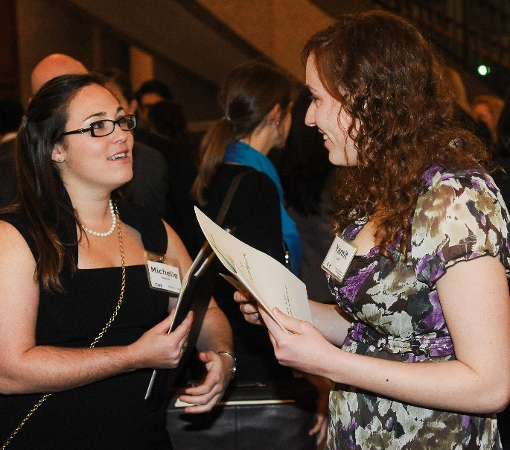
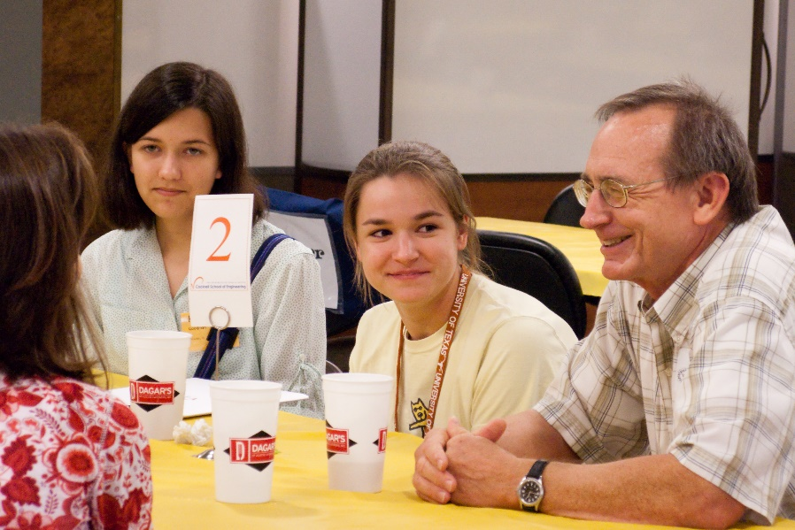
Role Model Introduction
Notes:
The ice breaker, as mentioned, can lead into the role model introduction.

Slide 20
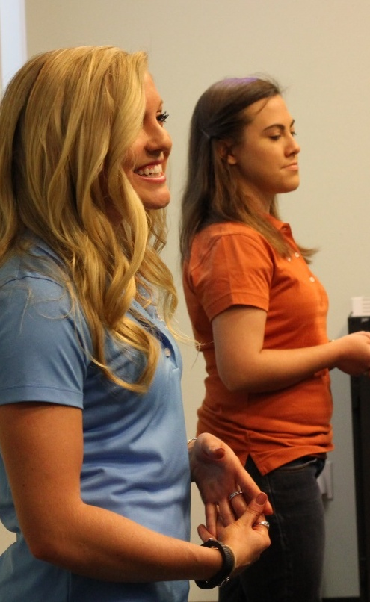
Role Model Introduction
Use effective messaging language
Share how your work is making our world a better place
Share successes and failures (encourage the growth mindset)
Make it personal and connected
Notes:
In the introduction, you want to share who you are and make it personal. You should share who you are and try to use some of the effective messages from the research and talk about how the work you are doing is making the world a better place. The more specific you can get, the better – give real examples or use analogies to things kids would connect with. Use kid-friendly language – avoid acronyms or technical terms that kids may not understand. Share your academic and career path – what did you do or enjoy when you were in their grade? Share any struggles or challenges you had along the way – this ensures that you and your role are accessible to the students and they see you don’t have to be perfect or brilliant to get there. Be excited and passionate about what you share…your excitement about your work and about STEM will rub off on the kids! And don’t forget to make it personal by sharing hobbies or other things you like to do that showcase how you are a normal person with just a not so normal job (remember back to Amy from the Fermilab visit).
ACTIVITY: If there is time, have the role models work a bit on their introduction. How would they introduce themselves to kids? Have them write out some bullet points. Have them work in teams to brainstorm the real world connections or analogies to the work they do that would make sense to kids.

Slide 21
Hands-on Activity
Notes:
Let’s do a hands-on activity!!
Several hands-on activities are available on the TechTitans STEM Education Resource link.
Facilitation Tips:
Adjust group size if needed. Could be done in groups of 2-3. Would avoid getting groups of 5 ore more so that all can participate.
Use easy materials – index cards, recycled paper, newspaper, etc. Tape is not required but you can provide it if you want – people get really creative without tape and it forces them to creatively problem solve a bit more.
Give a time limit based on the amount of time you have available.
Walk around and role model the behavior of reinforcing the growth mindset and other important engineering concepts: highlighting the struggle, pointing out the problem solving process involved, commenting on creative designs or solutions, commenting on effective teamwork, etc.
Close the activity out by asking everyone to take a look at all the fabulous towers created. Most likely the groups will have turned this into a competition. Diffuse that by saying that we are all from the same company so all the designs are valuable – the one that gets put out into the marketplace may include some of the best solutions from several of the designs. You can point out some of the unique things from various towers to reinforce the collaboration concept.
Sub in another activity if there is one that you want to train role models on specifically. The facilitation tips can be used regardless of the activity.

Slide 22
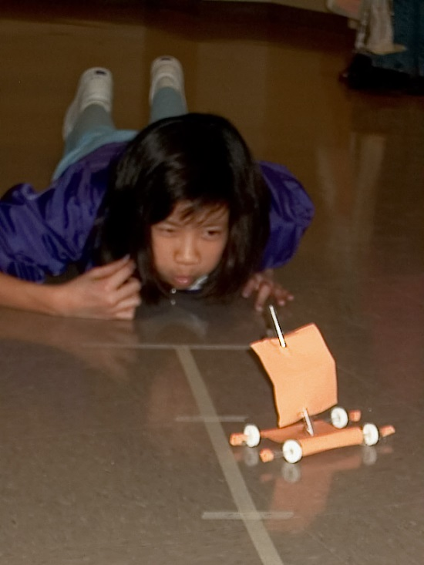
Hands-on Activity
Give useful and specific feedback
Use questions
Promote inquiry
Highlight the challenge
Praise the effort
Notes:
As the kids are doing the hands-on activity, here are some facilitation tips. I was using some of these as I went around to your towers (give some specific examples if possible). When the kids ask questions, ask them a question back such as “what do you think?” Praise their effort and highlight any struggles that they may have had and showcase what they accomplished when they overcame the struggle. Ask questions to get them thinking about how the activity connects to their math or science classes or back to the ice breaker you shared or to other real world connections. Avoid saying, “that’s so smart” or “that’s a smart idea”.

Slide 23
Reinforce the Growth Mindset
Teach children that intellectual skills can be acquired.
Praise the effort.
Highlight the struggle.
Gifted programs should send the message that they value growth and learning.
Fixed Mindset | Growth Mindset
Intelligence is static. | Intelligence can be developed.
Leads to a desire to look smart and therefore a tendency to | Leads to a desire to learn and therefore a tendency to
avoid challenges | embrace challenges
give up easily due to obstacles | persist despite obstacles
see effort as fruitless | see effort as path to mastery
ignore useful feedback | learn from criticism
be threatened by others’ success | be inspired by others’ success
AAUW Why So Few
Notes:
We don’t want to use language such as “you’re so smart” as that plays into the fixed mindset. Individuals with a “fixed mindset” believe that intelligence is static. Because of this, they want to always “look smart” and therefore, tend to avoid challenges, give up easily when they encounter an obstacle, see effort as fruitless, ignore feedback, and can be threatened by others’ success.
In contrast, individuals with a “growth mindset” believe that intelligence can be developed. Because of this they want to learn more and, therefore, tend to embrace challenges, persist when they encounter obstacles, see effort as a path to mastery , learn from criticism, and be inspired by the success of others.
Individuals with a fixed mindset are susceptible to a loss of confidence when they encounter challenges, because they believe that if they are truly “smart,” things will come easily to them. If they have to work hard at something, they tend to question their abilities and lose confidence, and they are likely to give up because they believe they are “not good” at the task and believe that because their intelligence is fixed, they will never be good at it.
Individuals with a growth mindset, on the other hand, show a far greater belief in the power of effort, and in the face of difficulty, their confidence actually grows because they believe they are learning and getting smarter as a result of challenging themselves.
These research findings are important for women in STEM, because encountering obstacles and challenging problems is in the nature of scientific work. When girls and women believe they have a fixed amount of intelligence, they are more likely to lose confidence and disengage from science and engineering when they inevitably encounter difficulties in their course work.
This is true for all students, but it is particularly relevant for girls and other minorities in math and science, where negative stereotypes persist about their abilities.
Therefore, in math and science, a growth mindset benefits girls and minorities. So how can parents and teachers and role models promote a growth mindset? We recommend the following:
Parents and teachers should teach children that intellectual skills can be acquired. When girls are taught that their intelligence can expand with experience and learning, they do better on math tests and are more likely to want to continue to study math in the future.
Praise children for effort. Rather than saying, “Oh, you’re so smart!” when children do something well, say “Wow, you worked really hard at that and you did it!” It is especially important to praise the most able students for their effort. These students have often coasted along, gotten good grades, and been praised for their intelligence and may be the very students who opt out when the work becomes more difficult.
Highlight the struggle. Parents and teachers can communicate to students that we value and admire effort and hard work. This will teach children the values that are at the heart of scientific and mathematical contributions: love of challenge, love of hard work, and the ability to embrace and learn from our inevitable mistakes.
Talented and gifted programs should send the message that they value growth and learning, not just being “gifted” with intelligence.
(Slide and facilitator notes from AAUW Why So Few Report and Presentation.)
HANDOUT: Growth Mindset Graphic

Slide 24
Notes:
It’s great to refer to the engineering design process in the reflection. If you can show this slide or draw out the design process on a white board in the classroom, great! The visual helps, especially for those kids who are visual learners. Connect it to the activity they did and give some specific examples of parts of the process if possible. And don’t forget to mention how important presenting solutions is in the process. We want kids to understand that writing and communicating are just as important for engineers and scientists as for everyone else.

Slide 25
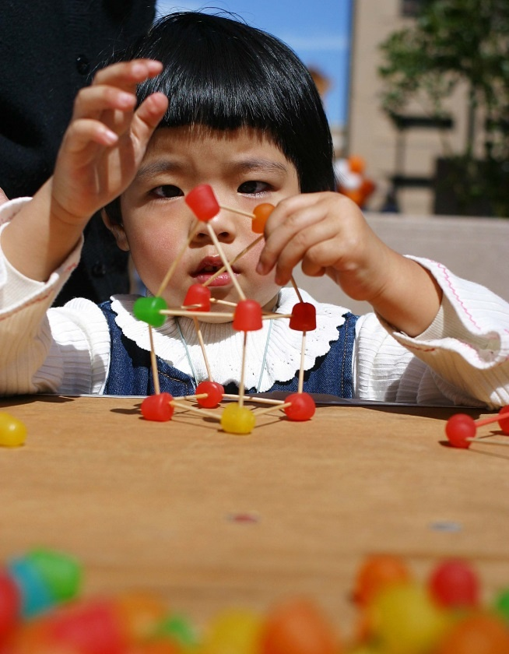
Reflection - Make it Meaningful
Connect the activity to...
Kids' lives
Careers
STEM
Other activities or disciplines
Make connections throughout the hands-on activity.
Notes:
The last activity within the role model visit is the reflection. Connections should be made throughout the role model visit….from the icebreaker to the introduction to the hands-on activity. But it’s good to wrap it up by focusing in on the reflection and the real world connections. Connect the activity the kids just did with things they know. Ask them how the activity they did connects to their world. How did the tower connect to our world? (Have participants make connections – buildings, towers with strong bases, triangles in structures, Eiffel Tower, UT Tower, engineers have to create things with limited materials or in limited time, different ideas still got towers that stood up – creativity of design is important, etc.)
Facilitation Tip: If you are advocating for the use of a particular activity or the role model(s) know what activity they will be doing, get specific on this slide and brainstorm real world connections with them.

Slide 26
Find STEM in your everyday life ... & use resources to help you!
Sports
Cooking
Driving
Games & Apps
Music
Health & Medicine
PBS
MythBusters
STEM & Puzzle Apps
STEM Camps
Museums & Centers
Mini-Maker Faire
UT Austin Events

Slide 27
Notes:
Now you should hopefully have a better idea of how to mix up the “secret sauce” to have a successful role model experience with kids. Again, it’s about being excited and passionate, sharing the personal stuff so they know you’re a real person too, and making it informal and interactive with the hands-on activity.

Slide 28
Resources

Slide 29
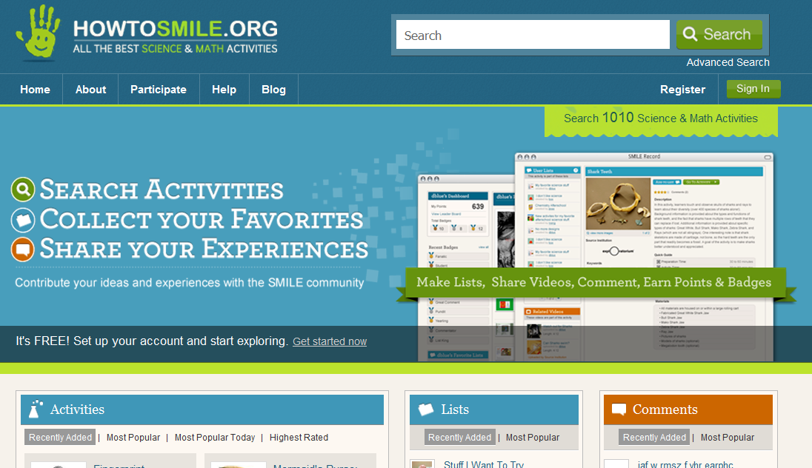
Collaborative Effort including Lawrence Hall of Science, Exploratorium,
New York Hall of Science, Science Museum of Minnesota, Children’s Museum of Houston
Notes:
HowToSmile.org is a great resource if you are looking for age-appropriate hands-on STEM activities. It’s a fabulous online searchable database of great STEM activities. You can search on grade or age, length of activity, cost of activity, subject area, etc.

Slide 30
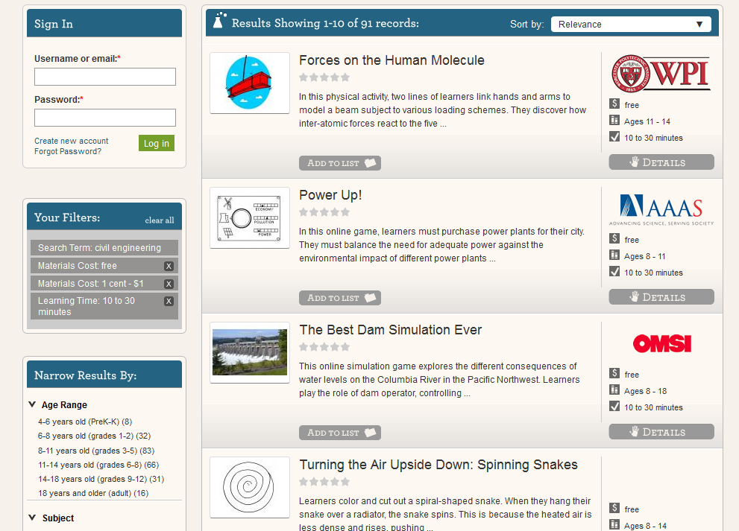
Searched:
Civil Engineering
Free - $1.00
10 – 30 minutes
Notes:
As an example, here is a search for a civil engineering activity that lasts 10-30 minutes and costs no more than $1.00. Over 90 activities came up in this search and it could be narrowed further by selecting the age range or any of the other criteria.
Again, it’s a great resource with activities complete with materials lists, facilitation guides, handouts for students and more!

Slide 31
Finding & Being Role Models
Regional K12 STEM
Outreach Google Groups
www.stemfire.com
http://txgcp.org/k12-stem-outreach-google-group/
www.millionwomenmentors.org
Notes:
STEMfire matches STEM volunteers to classrooms. Teachers post an event and volunteers sign up for those events.
Regional K12 STEM Outreach Google Groups provide connections, resources and a sense of community across all engaged in K-12 STEM outreach in the region. You can find out about volunteer opportunities or post information about needing volunteers to the group.
Million Women Mentors is a place to pledge to be a role model and to also find role model opportunities in the community. Texas has pledged to engage 20,000 mentors in the next 4 years.

Slide 32
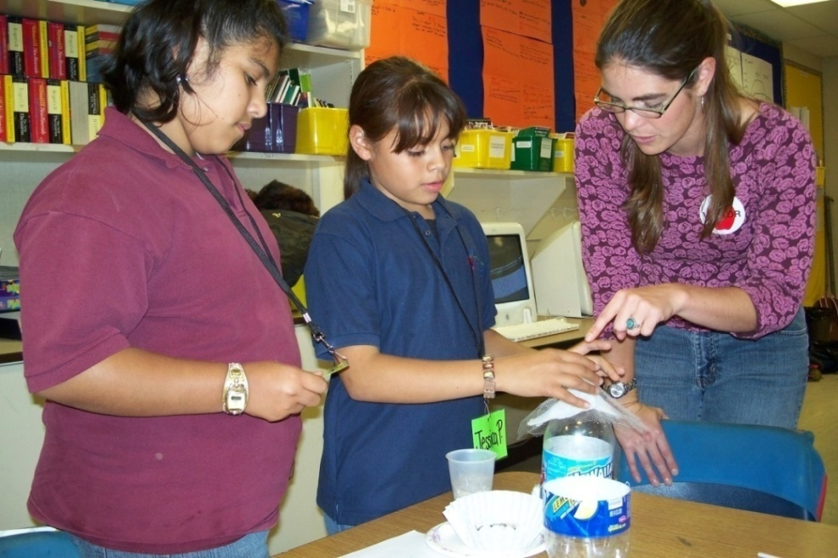
Techbridge Resources
Role Model Guide
Techbridge Tips
Online Training
www.techbridgegirls.org
Notes:
Techbridge has additional role model resources on their website including a role model guide, online role model training, and additional tips for being an effective role model. If your role models can’t all participate in this training, the Techbridge resources are a great place to point your volunteers so they help send the right message when engaging with kids.

Slide 33
« «
The TxGCP connects organizations and individuals across Texas committed to informing and motivating girls to pursue careers in science, technology, engineering and mathematics (STEM).
« « «
Free Hands-on STEM Activities
STEM Program Directories
Effective STEM Messaging Resources
K-12 STEM Outreach Program Assessment Resources
http://www.txgcp.org « STEM@txgcp.org
Notes:
Additional resources can be found on the Texas Girls Collaborative Project resources page. You’ll find additional hands-on activity resources, messaging resources (including the links to the research reports mentioned earlier) and assessment tools for those who want to measure their direct impact.

Slide 34
More Resources!
Six Quick Tips for Sudden STEM Teachers
http://www.middleweb.com/24879/six-quick-tips-for-sudden-stem-teachers/
Notes:
More resources if needed:
http://www.middleweb.com/24879/six-quick-tips-for-sudden-stem-teachers/
It was great meeting you at the Metroplex Technology Business Council workshop on Wednesday. What a great group – thanks for your engagement and questions and sharing of experiences throughout!
The Texas Girls Collaborative Project (TxGCP) connects non-profits, K-12 schools, higher education institutions, companies, organizations and individuals across the state of Texas committed to informing and motivating girls to pursue careers in science, technology, engineering and mathematics (STEM). Led by the Women in Engineering Program (WEP) at The University of Texas at Austin as part of the National Girls Collaborative Project network, TxGCP provides forums, curriculum, best practices and resources to foster collaborations, build capacity of participating organizations, and create a state-wide network of informed and connected informal and formal STEM educators and advocates.
TxGCP provides many opportunities for individuals and organizations across Texas to meet or reconnect, learn about each other’s work, and develop ways to work together to better serve girls and young women in STEM. TxGCP is disseminating Best Practices in Effective STEM Marketing and Messaging, PBS SciGirls STEM Curriculum, Techbridge Role Models Matter Curriculum, and Water Works Underwater LEGO Robotics Camp Curriculum across Texas. The TxGCP eNewsletter and social media provide information about upcoming TxGCP events, mini-grant opportunities, collaborations, news and K-12 STEM outreach across Texas. In addition, regional K-12 STEM Outreach Google Groups set up around the state provide connections, resources and a sense of community across the region.
www.txgcp.org
https://www.facebook.com/TxGCP
https://twitter.com/TXGCP
I promised to share some resources:
· Role Models Matter – Presentation from the workshop - https://www.dropbox.com/s/vyjjx38b5f9y109/RoleModelsMatter.pdf?dl=0
· The list of participants from the workshop is below my signature at the bottom of this email. Hope you all continue to connect and collaborate!
· Effective Messaging Resources (http://txgcp.org/effective-stem-messaging-resou/) - Scroll down to the “Effective Messaging Resources” to find the Changing the Conversation, Why so Few? and other research reports on what images and words to use to engage kids in STEM.
· In addition to signing up in STEMfire to be a role model in a classroom, check out the following mentoring resources: enter your profile as a STEM professional or connect your students to www.fabfems.org (new and growing database of female STEM professionals), sign up to visit a classroom virtually through www.nepris.com, and check out the STEM mentor resources at http://txgcp.org/stem-role-models-resources/. And consider being a part of the Million Women Mentors movement where all STEM mentors/role models (men and women) are encouraged to mentor girls (and all kids) in STEM.
· Head to www.howtosmile.org for great hands-on STEM activities or visit http://txgcp.org/k-12-stem-outreach-hands-on-ac/ for our list of favorites.
· K-12 STEM Outreach Google Groups – you have been added to the group for DFW to get connected to resources, collaborators, funding, etc. - http://txgcp.org/k12-stem-outreach-google-group/. If you decide the emails aren’t useful to you, there is easy unsubscribe information at the bottom. Please share with others who may want to be on the list!
· Watch for the TxGCP eNewsletter that goes out monthly (or less) – you will be added to the distribution! Again, there is an easy unsubscribe at the bottom if you end up not interested. Please share with others who may want to receive it!
· Add your program to the National Girls Collaborative Project (NGCP) Program Directory to gain access to mini-grants and other opportunities - http://txgcp.org/programdirectory/.
Please let me know if there is anything else I can help with!

